Slide 1
Data Structure and Algorithm
Stacks and Queues

Slide 2
Problem Solving with Stacks
Many mathematical statements contain nested parenthesis like :-
  (A+(B*C) ) + (C – (D + F))
We have to ensure that the parenthesis are nested correctly, i.e. :-
  There is an equal number of left and right parenthesis
  Every right parenthesis is preceded by a left parenthesis
Expressions such as ((A + B) violate condition 1
And expressions like ) A + B ( - C violate condition 2

Slide 3
Problem Solving (Cont….)
To solve this problem, think of each left parenthesis as opening a scope, right parenthesis as closing a scope
Nesting depth at a particular point in an expression is the number of scopes that have been opened but not yet closed
Let “parenthesis count” be a variable containing number of left parenthesis minus number of right parenthesis, in scanning the expression from left to right

Slide 4
Problem Solving (Cont….)
For an expression to be of a correct form following conditions apply
  Parenthesis count at the end of an expression must be 0
  Parenthesis count should always be non-negative while scanning an expression
Example :
  Expr: 7 – ( A + B ) + ( ( C – D) + F )
  ParenthesisCount: 0 0 1 1 1 1 0 0 1 2 2 2 2 1 1 1 0
  Expr: 7 – ( ( A + B ) + ( ( C – D) + F )
  ParenthesisCount: 0 0 1 2 2 2 2 1 1 2 3 3 3 3 2 2 2 1

Slide 5
Problem Solving (Cont….)
Evaluating the correctness of simple expressions like this one can easily be done with the help of a few variables like “Parenthesis count”
Things start getting difficult to handle by your program when the requirements get complicated e.g.
Let us change the problem by introducing three different types of scope de-limiters i.e. (parenthesis), {braces} and [brackets].
In such a situation we must keep track of not only the number of scope delimiters but also their types
When a scope ender is encountered while scanning an expression, we must know the scope delimiter type with which the scope was opened
We can use a stack ADT to solve this problem

Slide 6
Problem Solving with Stack
A stack ADT can be used to keep track of the scope delimiters encountered while scanning the expression
Whenever a scope “opener” is encountered, it can be “pushed” onto a stack
Whenever a scope “ender” is encountered, the stack is examined:
  If the stack is “empty”, there is no matching scope “opener” and the expression is invalid.
  If the stack is not empty, we pop the stack and check if the “popped” item corresponds to the scope ender
  If match occurs, we continue scanning the expression
When end of the expression string is reached, the stack must be empty, otherwise one or more opened scopes have not been closed and the expression is invalid

Slide 7
Why the need for a Stack
Last scope to be opened must be the first one to be closed.
This scenario is simulated by a stack in which the last element arriving must be the first one to leave
Each item on the stack represents a scope that has been opened but has yet not been closed
Pushing an item on to the stack corresponds to opening a scope
Popping an item from the stack corresponds to closing a scope, leaving one less scope open

Slide 8
Stack in Action ….
top
[
{
-
C
+
(
+
B
D
+
E
)
}
]
A

Slide 9
Stack in Action ….
top
Push( ‘[‘ );
[
[
{
-
C
+
(
A
+
B
D
+
E
)
}
]

Slide 10
Stack in Action ….
top
{
Push( ‘{‘ );
[
[
{
-
C
+
(
A
+
B
D
+
E
)
}
]

Slide 11
Stack in Action ….
top
(
{
Push( ‘(‘ );
[
[
A
+
{
B
-
C
+
(
D
+
E
)
}
]

Slide 12
Stack in Action ….
top
(
{
Pop( );
[
[
A
+
{
B
-
C
+
(
D
+
E
)
}
]

Slide 13
Stack in Action ….
top
{
[
[
{
-
C
+
(
A
+
B
D
+
E
)
}
]

Slide 14
Stack in Action ….
top
{
Pop( );
[
[
{
-
C
+
(
A
+
B
D
+
E
)
}
]

Slide 15
Stack in Action ….
top
[
[
{
-
C
+
(
A
+
B
D
+
E
)
}
]

Slide 16
Stack in Action ….
top
Pop( );
[
[
{
-
C
+
(
A
+
B
D
+
E
)
}
]

Slide 17
Stack in Action ….
top
[
{
-
C
+
(
+
B
D
+
E
)
}
]
A
Result = A valid expression

Slide 18
Infix, Postfix and Prefix Notations
The usual way of expressing the sum of two numbers A and B is :
A+B
The operator ‘+’ is placed between the two operands A and B
This is called the “Infix Notation”
Consider a bit more complex example:
(13 – 5) / (3 + 1)
When the parentheses are removed the situation becomes ambiguous
13 – 5 / 3 + 1
is it (13 – 5) / (3 + 1)
or 13 – (5 / 3) + 1
To cater for such ambiguity, you must have operator precedence rules to follow (as in C++)

Slide 19
Infix, Postfix and Prefix Notations
In the absence of parentheses
13 – 5 / 3 + 1
Will be evaluated as 13 – (5 / 3) + 1
Operator precedence is by-passed with the help of parentheses as in (13 – 5) / (3 + 1)
The infix notation is therefore cumbersome due to
  Operator Precedence rules and
  Evaluation of Parentheses

Slide 20
Postfix Notation
It is a notation for writing arithmetic expressions in which operands appear before the operator
E.g. A + B is written as A B + in postfix notation
There are no precedence rules to be learnt in it.
Parentheses are never needed
Due to its simplicity, some calculators use postfix notation
This is also called the “Reverse Polish Notation or RPN”

Slide 21
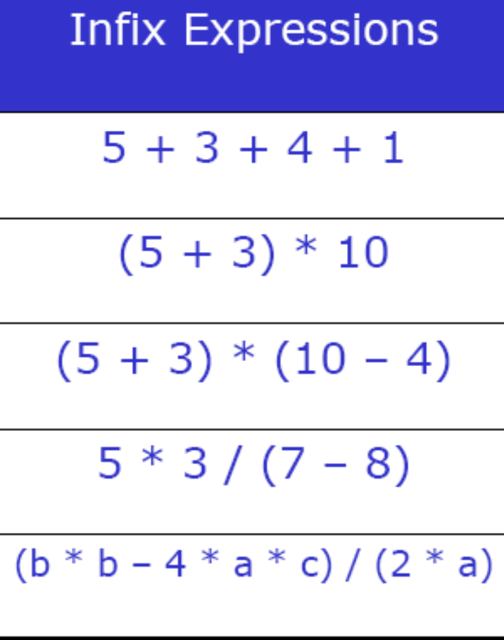
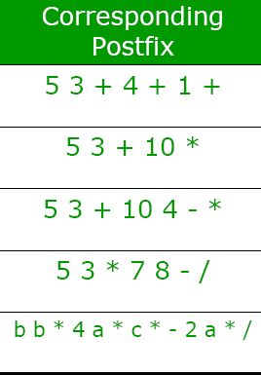
Postfix Notation – Some examples

Slide 22
Conversion from Infix to Postfix Notation
We have to accommodate the presence of operator precedence rules and parentheses while converting from infix to postfix
Data objects required for the conversion are:
  An operator / parentheses stack
  A Postfix expression string to store the resultant
  An infix expression string read one item at a time

Slide 23
Conversion from Infix to Postfix
The Algorithm
  What are possible items in an input Infix expression
  Read an item from input infix expression
  If item is an operand append it to postfix string
  If item is “(“ push it on the stack

Slide 24
Conversion from Infix to Postfix
  If the item is an operator
    If the operator has higher precedence than the one already on top of the stack then push it onto the operator stack
    If the operator has lower precedence than the one already on top of the stack then
      pop the operator on top of the operator stack and append it to postfix string, and
      push lower precedence operator onto the stack

Slide 25
Conversion from Infix to Postfix
  If item is “)” pop all operators from top of the stack one-by-one, until a “(“ is encountered on stack and removed
  If end of infix string pop the stack one-by-one and append to postfix string

Slide 26
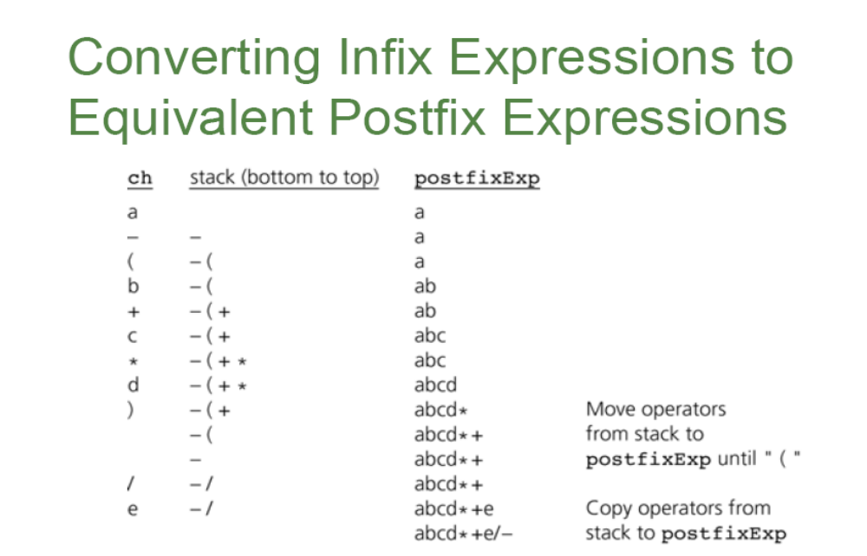

Slide 27
Try it yourself
Show a trace of algorithm that converts the infix expression
  ( X + Y) * ( P – Q / L)
  L – M / ( N * O ^ P )

Slide 28
Evaluation of Postfix Expression
After an infix expression is converted to postfix, its evaluation is a simple affair
Stack comes in handy, AGAIN
The Algorithm
  Read the postfix expression one item at-a-time
  If item is an operand push it on to the stack
  If item is an operator pop the top two operands from stack and apply the operator
  Push the result back on top of the stack, which will become an operand for next operation
  Final result will be the only item left on top of the stack

Slide 29
Stack in Action ….
Postfix Expression
5
7
+
6
2
-
*
top

Slide 30
Stack in Action ….
Postfix Expression
top
5
7
+
6
2
-
5
*

Slide 31
Stack in Action ….
Postfix Expression
top
7
5
7
+
6
2
-
5
*

Slide 32
Stack in Action ….
Postfix Expression
top
7
5
7
+
6
2
-
5
*
top
Result = Pop( ) “+” Pop( )
Push (Result)

Slide 33
Stack in Action ….
Postfix Expression
top
12
5
7
+
6
2
-
*

Slide 34
Stack in Action ….
top
Postfix Expression
6
12
5
7
+
6
2
-
*

Slide 35
Stack in Action ….
top
2
Postfix Expression
6
12
5
7
+
6
2
-
*

Slide 36
Stack in Action ….
top
2
top
Postfix Expression
6
4
12
12
5
7
+
6
2
-
*
Result = Pop( ) “-” Pop( )
Push (Result)

Slide 37
Stack in Action ….
top
Postfix Expression
4
12
5
7
+
6
2
-
*

Slide 38
Postfix Expression
top
4
top
5
7
+
6
2
-
*
12
48
Result = Pop( ) “ * ” Pop( )
Push (Result)

Slide 39
top
48
top
Postfix Expression
5
7
+
6
2
-
*
Result = Pop( )
Result = 48

Slide 40
Evaluation of Postfix Expression
Evaluation of infix Expression is difficult because :
  Rules governing the precedence of operators are to be catered for
  Many possibilities for incoming characters
  To cater for parentheses
  To cater for error conditions / checks
Evaluation of postfix expression is very simple to implement because operators appear in precisely the order in which they are to be executed

Slide 41
Motivation for the conversion
Motivation for this conversion is the need to have the operators in the precise order for execution
While using paper and pencil to do the conversion we can “foresee” the expression string and the depth of all the scopes (if the expressions are not very long and complicated)
When a program is required to evaluate an expression, it must be accurate
At any time during scanning of an expression we cannot be sure that we have reached the inner most scope
Encountering an operator or parentheses may require frequent “backtracking”
Rather than backtracking, we use the stack to “remember” the operators encountered previously

Slide 42
Assignment # 1
Write a program that gets an Infix arithmetic expression and converts it into postfix notation
The program should then evaluate the postfix expression and output the result
Your program should define the input and output format, enforce the format and handle Exceptions (exceptional conditions).
Use appropriate comments at every stage of programming

